Slide 1
Proton Plan Status
May Report
Eric Prebys

Slide 2
Agenda
Operations – Prebys
Technical Status/Director’s Review - Prebys
Cost/Schedule Report – Baller
2007 Shutdown - discussion

Slide 3
Operations

Slide 4
Operational Issues
General
  We have now fully recovered from the shutdown, and are delivering beam to both NuMI and MiniBooNE
  Record total protons delievered in a week
    1.2E19, August 12-18, 2006
MiniBooNE
  Record protons in an hour
    9E16
  Record protons in a week
    1.08E19
NuMI
  Proton delivery has been dominated by downtime
  Back on track for average proton delivery
  Met “super secret” 1E20 goal

Slide 5
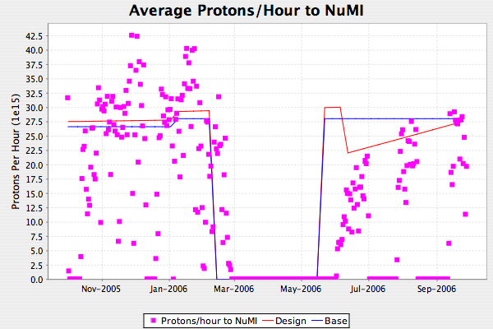
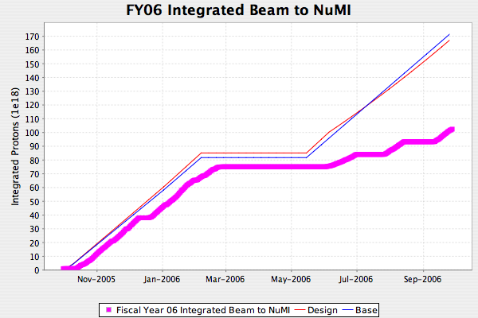
NuMI FY06
Horn problem
Bead problem

Slide 6
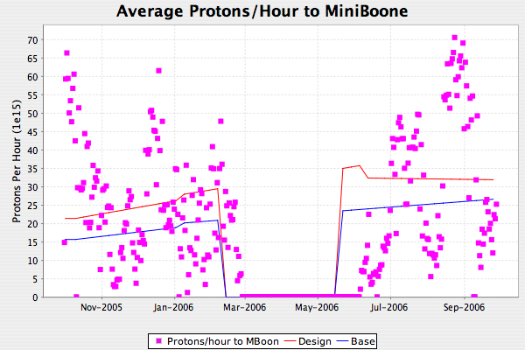
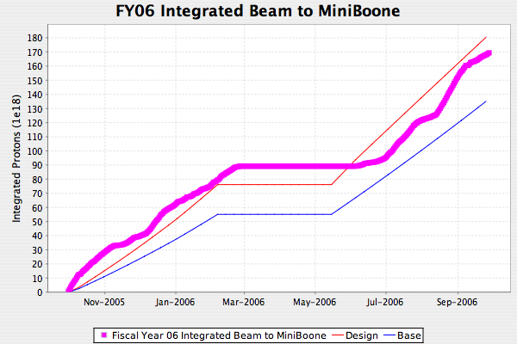
MiniBooNE FY06
Record week

Slide 7
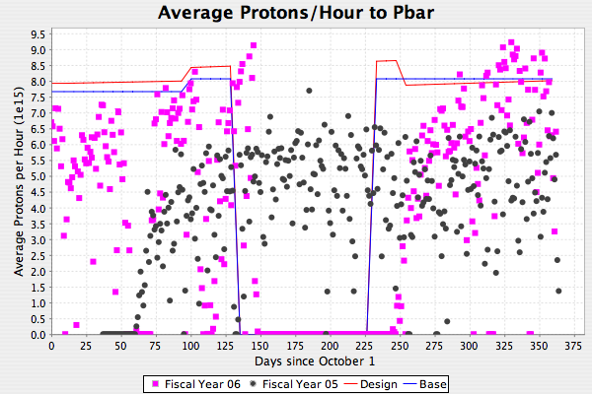
Big Difference from FY05: pBar
FY05 “hidden contingency”

Slide 8
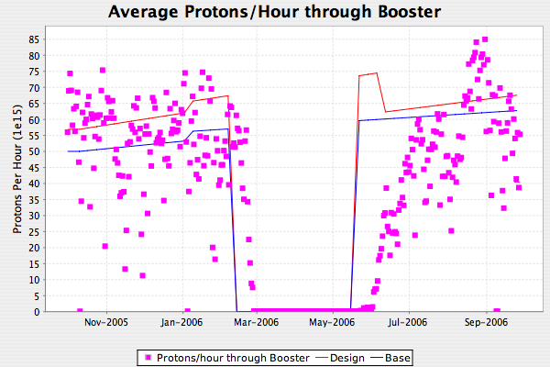
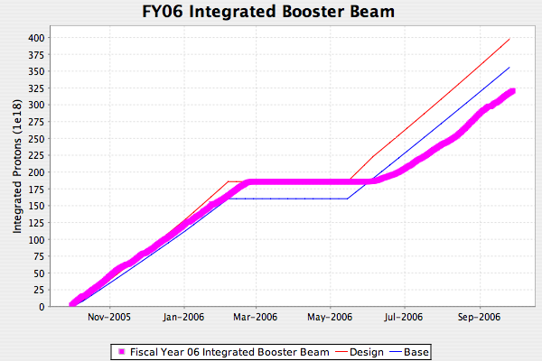
FY06 Total Booster Output

Slide 9
Technical Status

Slide 10
Significant Activity Since Last PMG
Linac (1.1)
  (1.1.4) 200 MHz LLRF
    Model more or less complete
    Working on exact scope of upgrade
(1.2) Booster
  (1.2.3) New Corrector System
    Prototype tests look good so far
    Working out installation details
    Review scheduled for Oct 10th
  (1.2.5) gamma-t
    Increased modeling efforts
    Studies continue
  (1.2.12) Booster notch chopper
    Conceptual design looks doable
    Working on mechanical design
(1.3) Main Injector
  (1.3.2) MI Collimation Systems
    Conceptual design of ring collimation passed review
    Design of system being finalized (see shutdown discussion)
  (1.3.4) MI RF
    Detailed scope of work needed for slip stacking
    On schedule to be completed by shutdown (see shutdown discussion)

Slide 11
Director’s Review
August 15-16, 2007

Slide 12
General Review Impressions
Details of the review (including closeout) can be found at the PP website
Both in public and in private, the reviewers were very impressed with the progress in the last year
Highlights:
  Completion of 7835 order and subsequent descoping of propose Thales test facility.
  Successful completion of major shutdown projects, particularly the two big Booster jobs
  Progress on corrector prototype
  Significant increase in understanding of the Main Injector RF and beam physics issues
  Management and tracking
Total of 27 recommendations
    6 Linac
    8 Booster
    4 Main Injector
    6 Management
    3 Cost and schedule
Obvious things, or things we were doing anyway are marked in green in green on the following slides (~12)

Slide 13
Linac Recommendations
It is important that enough resources are allocated to fully test and characterize twelve 7835 tubes. Even with warranty provided by Burle, it is important to test these tubes to determine early problem associated with fabrication and performance specifications.
  Comment: we’re hiring a technician
Repair of the 7835 test stand power amplifier should proceed with priority so that the testing of tubes can resume and the nature of the failure can be understood and standard repair procedures can be worked out.
The work on QPS control cards is essential to be given higher priority to proceed on a reasonably fast track. This work seems to have slowed down due to lack of adequate manpower
  Comment: this is really only in the PP because it was originally much larger project. We’re stretching the schedule to accommodate its reduced priority
Design effort should also be dedicated to come up with an acceptable design for the timing card. This also seems to suffer from lack of adequate manpower.

Slide 14
Linac (cont’d)
Perform consistent linac beam measurements and characterizations to quantify beam energy spread, and transverse emittance variations due to magnetic elements under different linac settings. This needs to be done in collaboration with machine physicists with the required booster beam parameters at the injection.
  Comment: the MTA line will really help with this
Based on the model, which is 99% complete, take the decision about the cavity amplitude and phase regulation architecture and proceed with design. Decide if direct rf feedback is realizable (in light of the drive saturation of the 7835s) and called for, or if feedforward is sufficient and cost effective. Consider if shot-to-shot adaptive feed forward, as opposed to beam current feedforward, is applicable.

Slide 15
Booster
Develop an installation plan and in-situ field test for the new correction elements to verify the proper connections.
  comment: good idea
Strengthen accelerator physics efforts to guide the implementation and commissioning of the correction systems. In particular with respect to tune and resonance control, utilize the experiences of other accelerators, both in performance and calculations, to aid in this effort. Develop a commissioning plan for the new correction elements.
At the next review, present the status of accelerator physics calculations for the injection process and for tune and resonance control.
At the next review, present the status of Booster beam performance (intensity and losses) with comparisons to prior years (pre- and post-2006 shutdown).
  comment (8-10): a lot of modeling has been done and continues to be done. We’re working to put this together in a concise manner.

Slide 16
Booster (cont’d)
Pursue the gamma-t beam studies over the course of the next six months and firm up the decision on the implementation of the gamma-t system. Use available codes to continue the modeling of transition crossing, including momentum aperture limitation, chromatic nonlinear effect, space charge and impedance induced bunch mismatch, microwave instabilities, and electron cloud.
Monitor the progress of the Booster chopper by presenting its status at PMGs as needed (approx. every three months?).
As requested at last year’s review, consider implementing RF feedback and beam loading compensation in the Booster to improve stability of bunch rotation required for slip stacking as well as reducing the RF power requirements associated with paraphrasing.
  comment: The RF group has started working on this, but has not been officially added to the PP scope as yet

Slide 17
Booster (cont’d)
Until improved stability of Booster RF during the bunch rotation process has been achieved by RF feedback, consider implementing the required matching of the Booster bunches to the MI slip stacking by gradually building up the quadrupole motion of the bunch by modulating the RF amplitude with twice the synchrotron frequency for a few synchrotron periods prior to extraction. This avoids the use of very low voltages in the Booster.
  comment: we have now implemented this as our standard mode of operation

Slide 18
Main Injector
Continue studies of MI 2+9 batch operation at high intensity to fully understand and remedy capture losses
Present a detailed plan for the MI ring collimation studies, design, fabrication, installation, and commissioning as soon as possible to permit installation in the 2007 shutdown.
Address and decide upon the MI RF upgrade CR’s as soon as possible.
Continue machine studies related to possible e-cloud effects and compare with simulations based on realistic data from SEY measurements.
  comment: effort in this area is being increased

Slide 19
Management
Provide additional detail when reporting on the status of follow-up activities associated with the recommendations from the August 2005 Director’s review. For the longer duration tasks, status information should include an indication of priority, detailed statement of work actively being performed, and target completion dates.
Provide a similar level of detail when providing progress status on recommendations from the 2006 review.
Update the project plan and scope of work to account for the resources required to address and close the recommendations from the August 2005 review. This represents real work with potential impact on the resource loaded schedule.
  comment (20-22): pretty much implemented

Slide 20
Management (cont’d)
Process pending Change Requests soon in order to factor the impact into the next round of schedule and cost forecast updating.
Flesh out the remaining work on developing subprojects and update the project schedule file with this information: (e.g., Linac LLRF, Gamma T magnets, booster chopper, MI collimation, extraction kicker mods). Task durations should be limited to two months or less in order to properly measure progress.
Assertively pursue resources to fill missing personnel slots (e.g., support for the management of the Corrector Systems Upgrade, RF engineering, tech to test QPS control cards).

Slide 21
Cost and Schedule
The remaining long duration tasks (i.e. greater than 2 months in duration) should be broken down into shorter duration detailed activities. This will help improve the accuracy of estimating resources and reporting progress. An alternative to breaking down the long duration activities is adding milestones that reflect interim deliverables that will indicate progress is being made to complete the long duration task.
  comment: working on this
A WBS Dictionary description should be completed for the remaining tasks. This will better define the work to be accomplished, which improves the accuracy of estimating the resources needed to complete the work and gives the people assigned to the tasks a better understanding of what the deliverable is.
The committee recommends that the Proton Plan analyze the critical and near critical path activities to determine what activities can be crashed to gain schedule contingency for the work scheduled to be performed in the 2007 and 2008 shutdowns.
    Comment: we’re looking into this, but unlikely to find big things

Slide 22
Preparation for 2007 Shutdown

Slide 23
Major 2007 Projects
Booster Corrector System
  Long straight correctors to be build and installed
  MAJOR project
  VERY tight schedule
Main Injector Collimation
  Conceptual design reviewed
  Mechanical design proceeding
  Tight schedule
Main Injector RF
  Scope of work necessary for NuMI slip stacking determined
    SIGNIFICANT accomplishement, largely thanks to Tim Berenc
  Schedule relies on availability of manpower

